Slide 1
Name:-Siba prasad sahu
Project: Interactive Website Development

Slide 2
Objective: To build a responsive and interactive website that incorporates various front-end development techniques, from basic HTML structure to advanced API integration and CSS preprocessing.
Task 1:
Basic HTML Page Steps:
1.Create an HTML file (index.html) with the basic structure including , , and tags. 2.Add a title to the webpage using the tag.
3.Insert headings, paragraphs, and an image within the body of the page.
4.Save the file and open it in a web browser to ensure proper rendering.

Slide 3
Index.html:-
<!DOCTYPE html>
<html lang="en">
<head>
<meta charset="UTF-8">
<meta name="viewport" content="width=device-width, initial-scale=1.0">
<title>My First Webpage</title>
</head>
<body>
<!-- Heading -->
<h1>Welcome to My First Webpage</h1>
<!-- Paragraph -->
<p>
This is a simple HTML page created as part of Task 1.
HTML stands for <b>HyperText Markup Language</b> and it is used to structure web content.
</p>

Slide 4
<!-- Sub-heading -->
<h2>About HTML</h2>
<p>
HTML is the standard markup language for creating web pages.
It describes the structure of a webpage using elements like headings, paragraphs, links, and images.
</p>
<!-- Image -->
<img src="https://via.placeholder.com/300" alt="Sample Image">
</body>
</html>
<!DOCTYPE html>
<html lang="en">
<head>
<meta charset="UTF-8">
<meta name="viewport"

Slide 5
content="width=device-width, initial-scale=1.0">
<title>My First Webpage</title>
</head>
<body>
<!-- Heading -->
<h1>Welcome to My First Webpage</h1>
<!-- Paragraph -->
<p>
This is a simple HTML page created as part of Task 1.
HTML stands for <b>HyperText Markup Language</b> and it is used to structure web content.
</p>
<!-- Sub-heading -->
<h2>About HTML</h2>
<p>

Slide 6
HTML is the standard markup language for creating web pages.
It describes the structure of a webpage using elements like headings, paragraphs, links, and images.
</p>
<!-- Image -->
<img src="https://via.placeholder.com/300" alt="Sample Image">
</body>
</html>

Slide 7
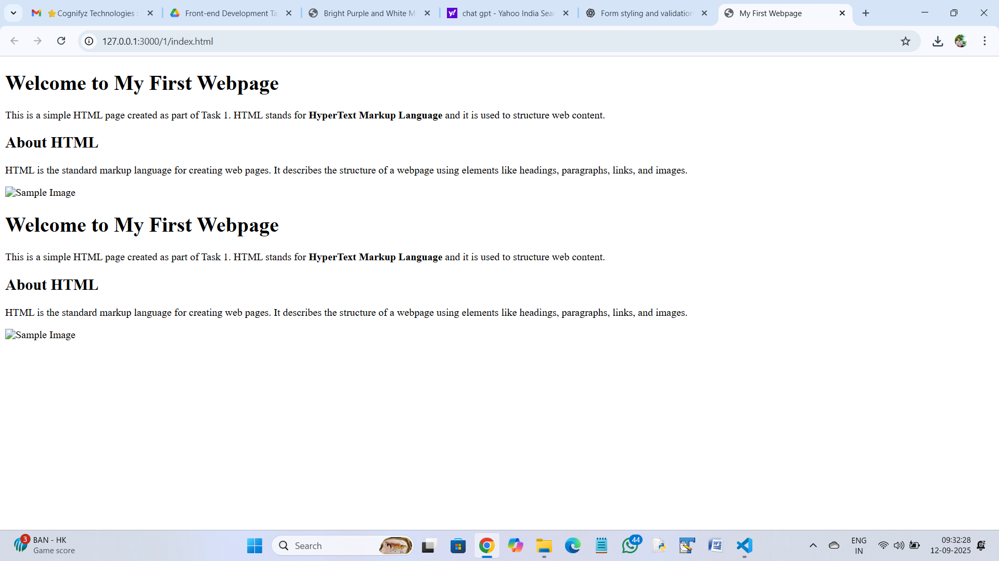
Output:-

